Slide 1

Introduction to Git

Slide 2

Overview
What is VCS?
Difference b/w SC & SCM
History of Source Control
Why VCS?
Types of VCS
Difference b/w Centralized and Distributed VCM
VCM Tools
Interest over time Graph
What is git?
Git vs GitHub
Features of Git
Git Architecture

Slide 3
Version Control System (VCS)
A way to manage files and directories
Track changes over time
Recall previous versions
‘Source control’ is a subset of a VCS

Slide 4
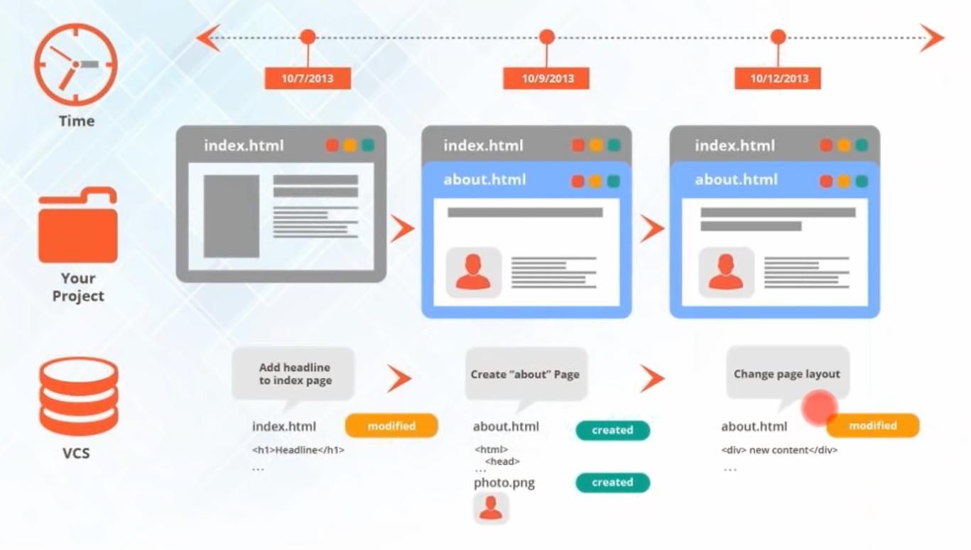

Slide 5

Source Control vs. Source Code Management (SCM)
These two terms are also used interchangeably.
However, source control is specific to tracking changes in source code.
And a source code management tool (SCM) tracks changes to a source code repository.
This is used to resolve conflicts when merging updates from multiple developers.

Slide 6
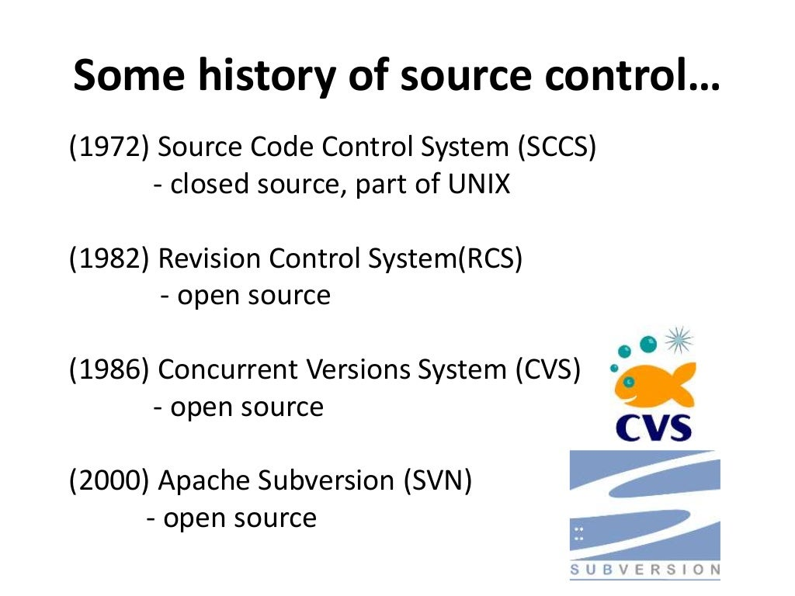

Slide 7
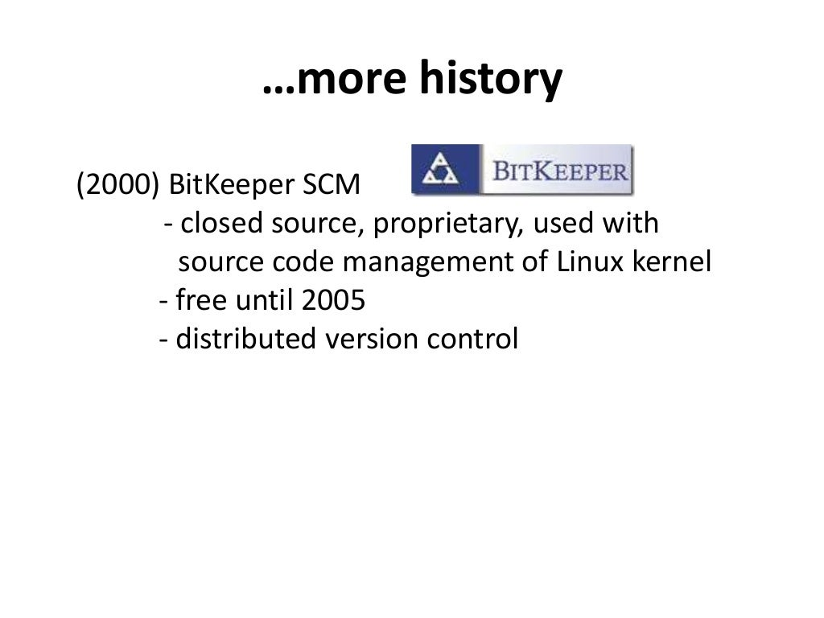

Slide 8
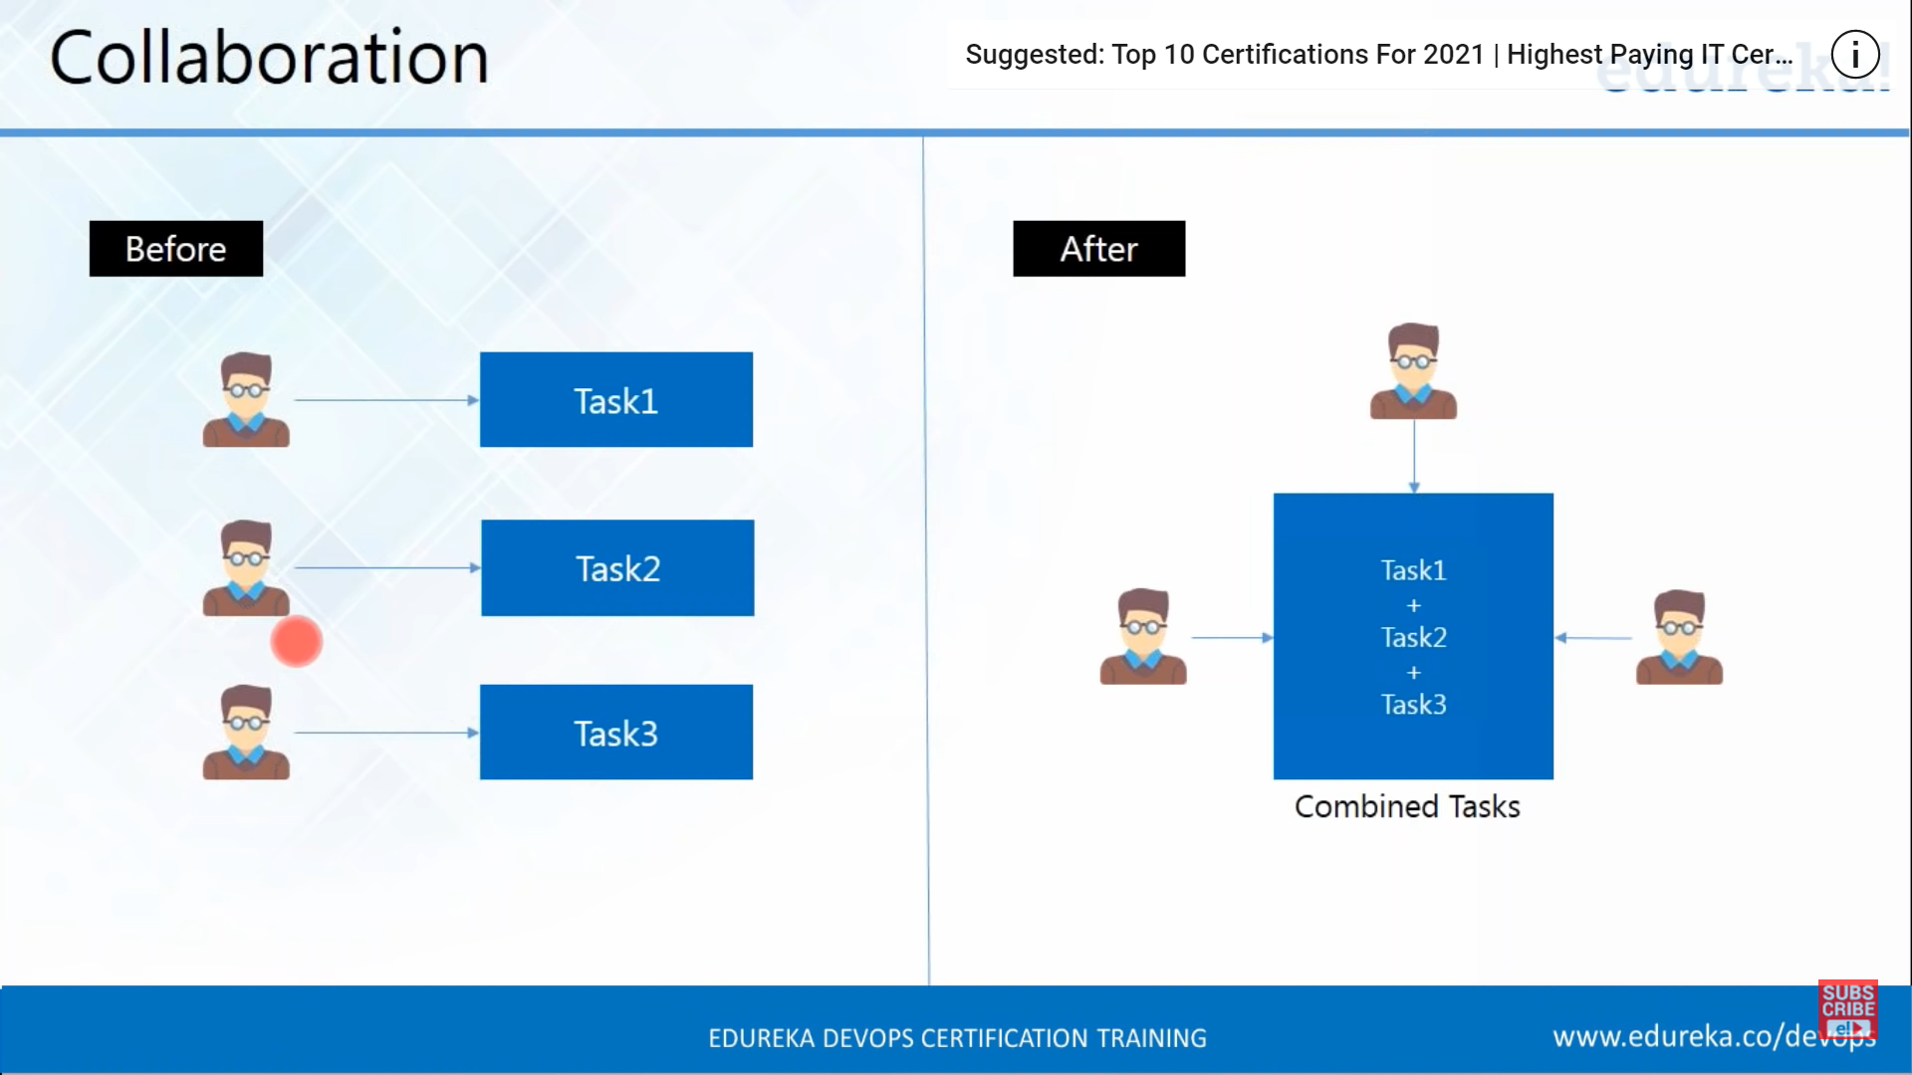
Collaboration

Slide 9
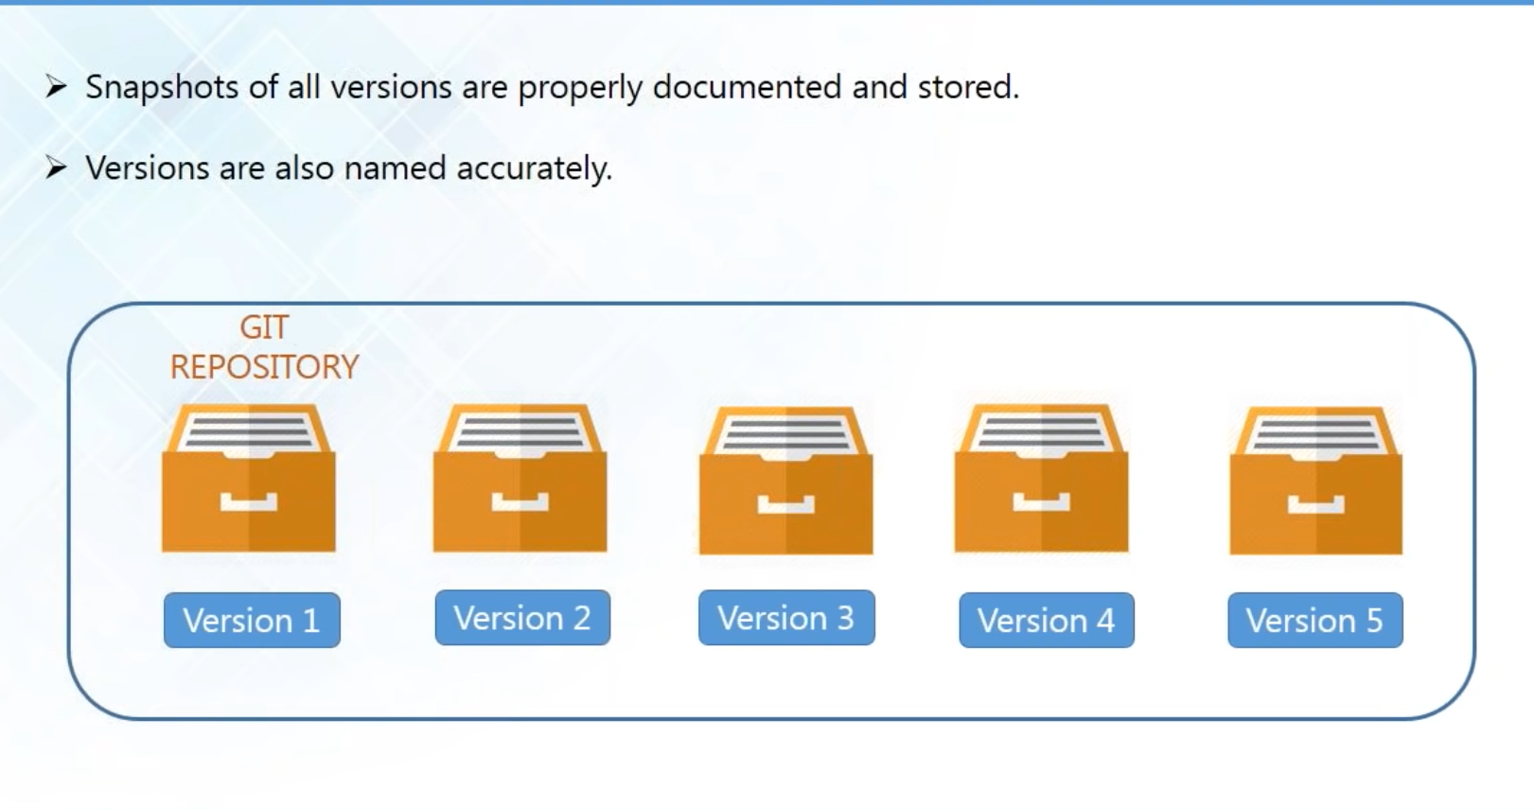
Storing Versions

Slide 10
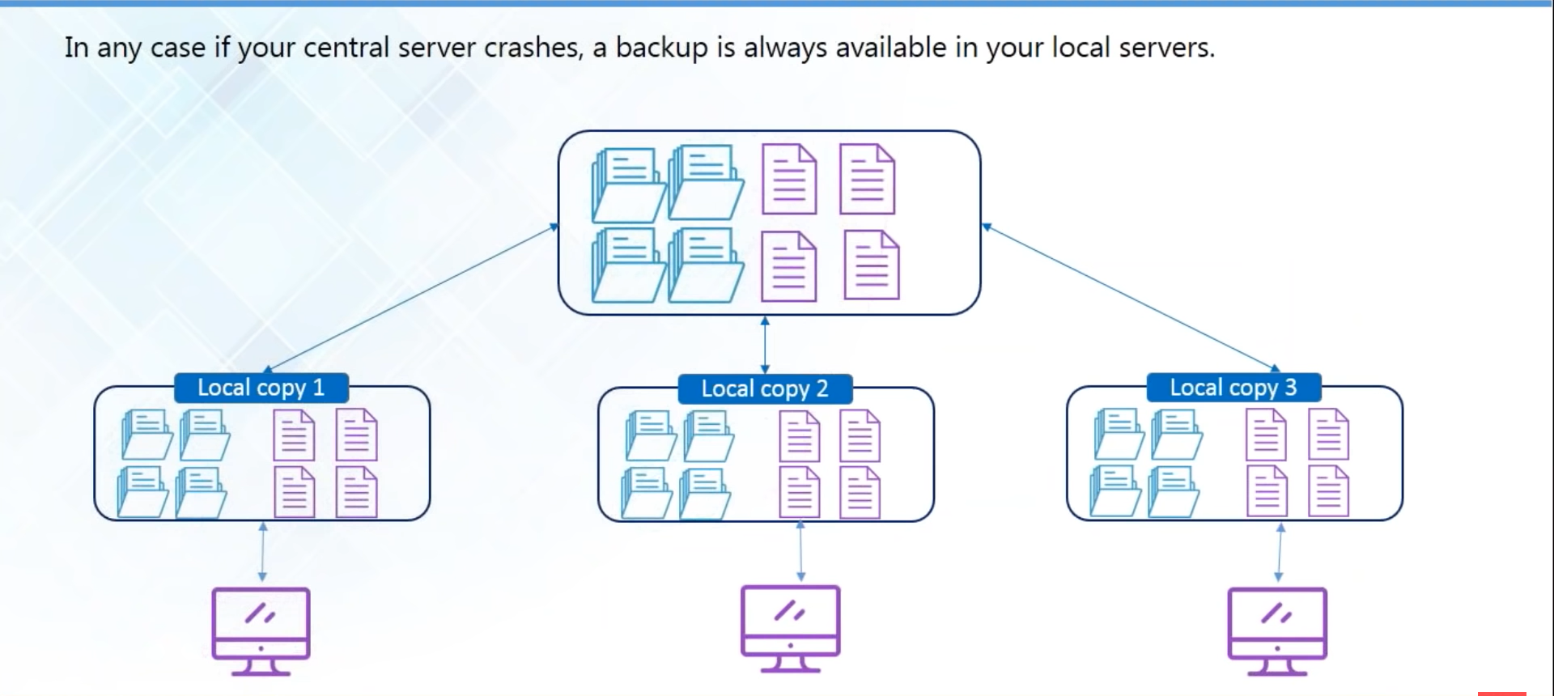
Backup

Slide 11
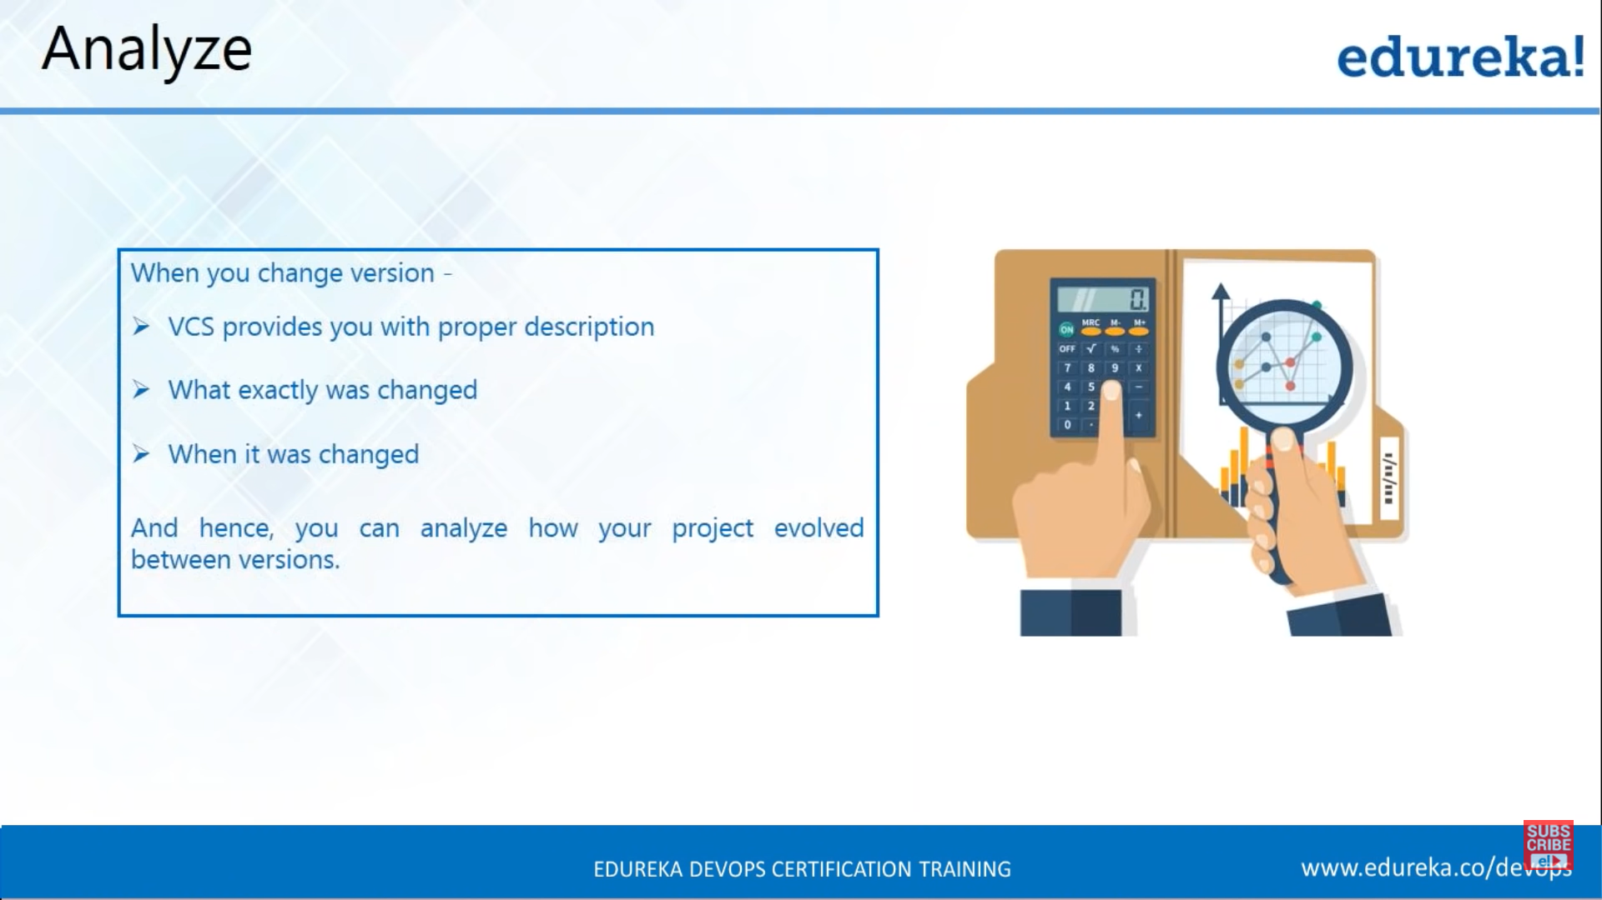
Analyse

Slide 12
Types of Version Control Systems:
Local Version Control Systems - a local database located on your local computer, in which every file change is stored as a patch.
Centralized Version Control Systems – contain just one repository globally and every user need to commit for reflecting one’s changes in the repository.
Distributed Version Control Systems – Each user has their own repository and working copy.

Slide 13
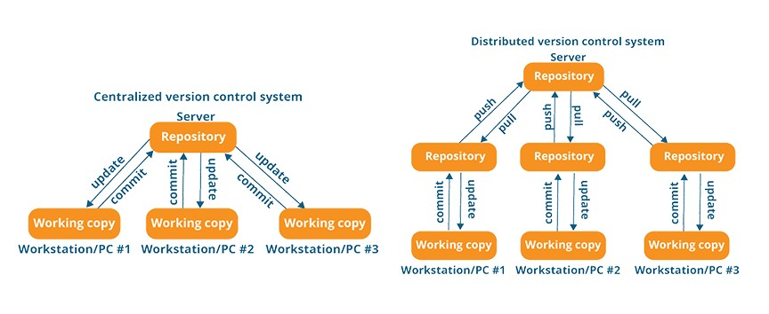

Slide 14
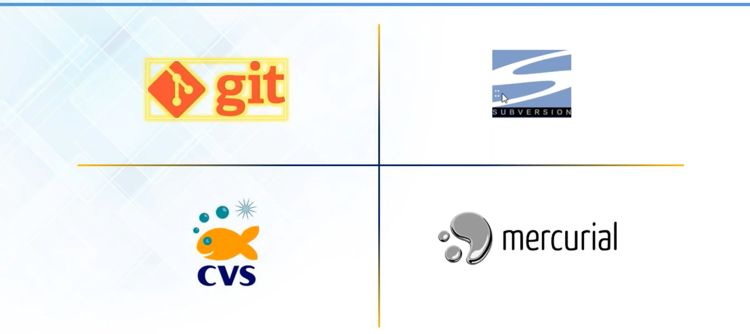
Version Control System Tools

Slide 15
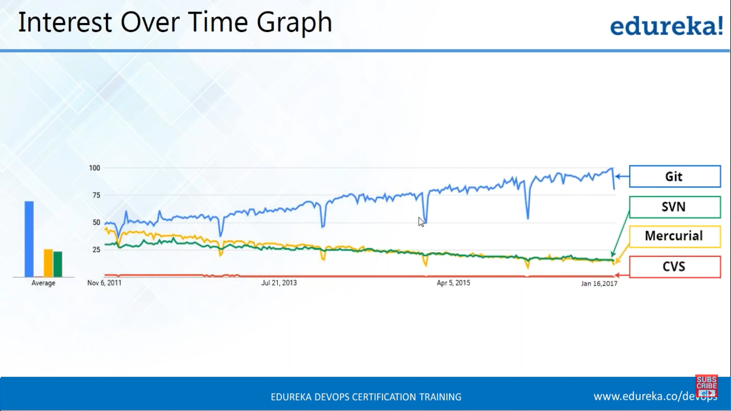
Interest Over Time Graph

Slide 16
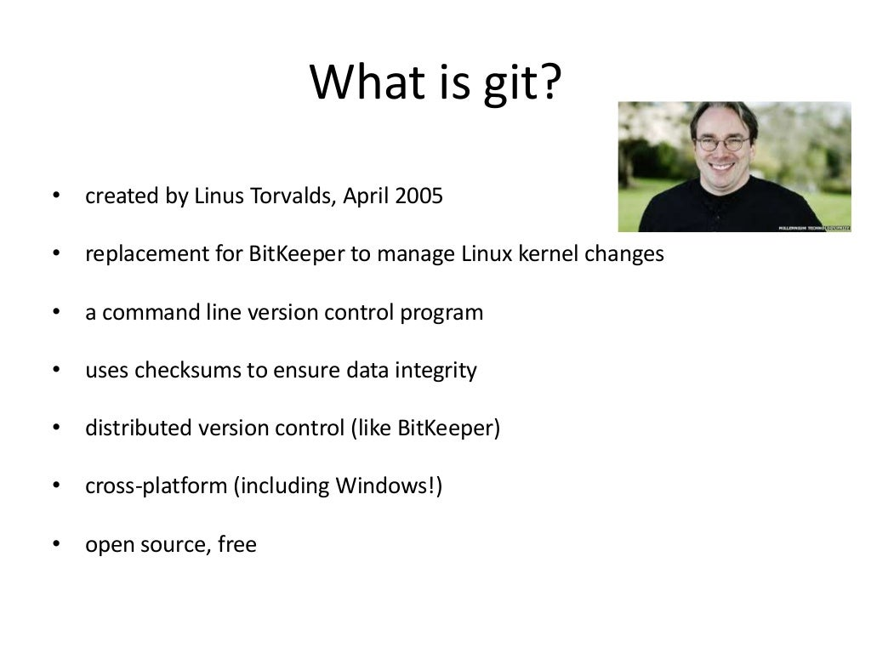

Slide 17
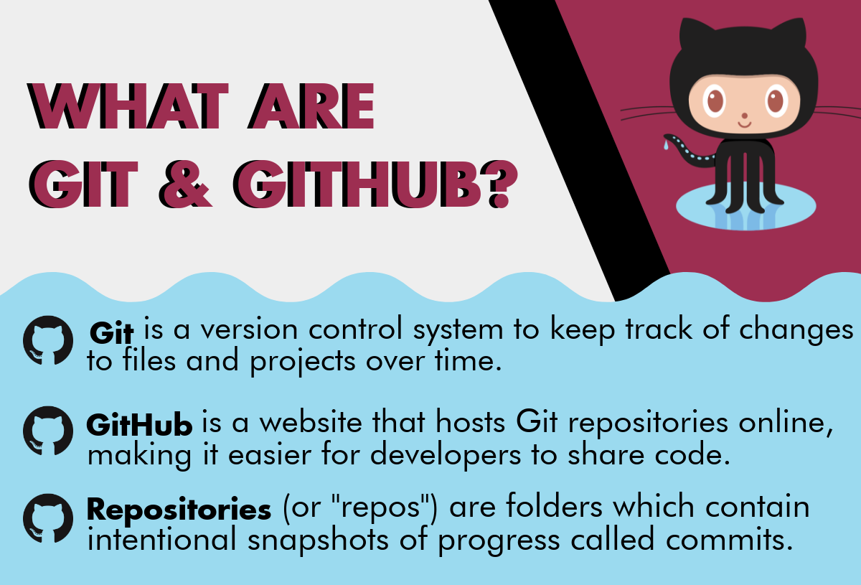

Slide 18
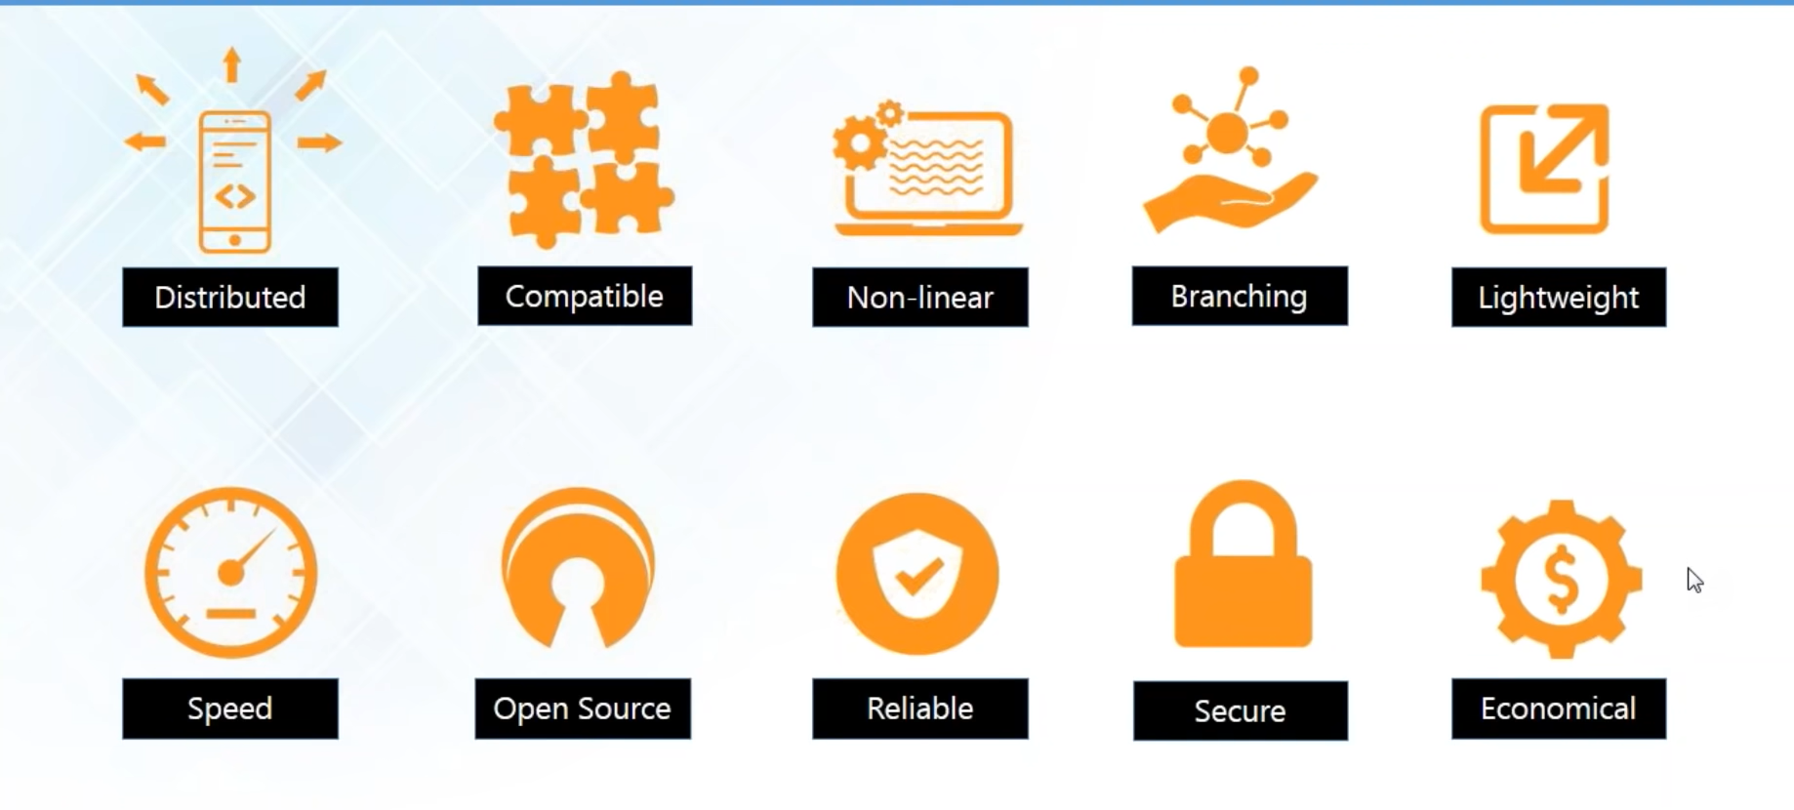
Features of Git

Slide 19
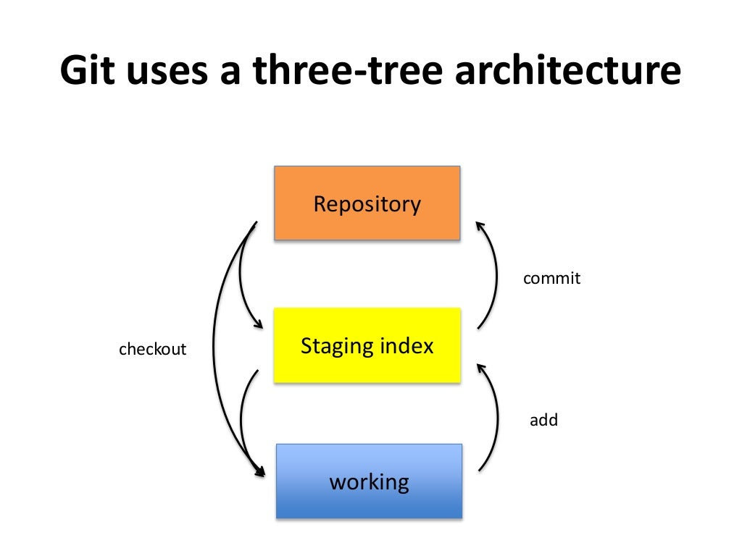

Slide 20


